Slide 1
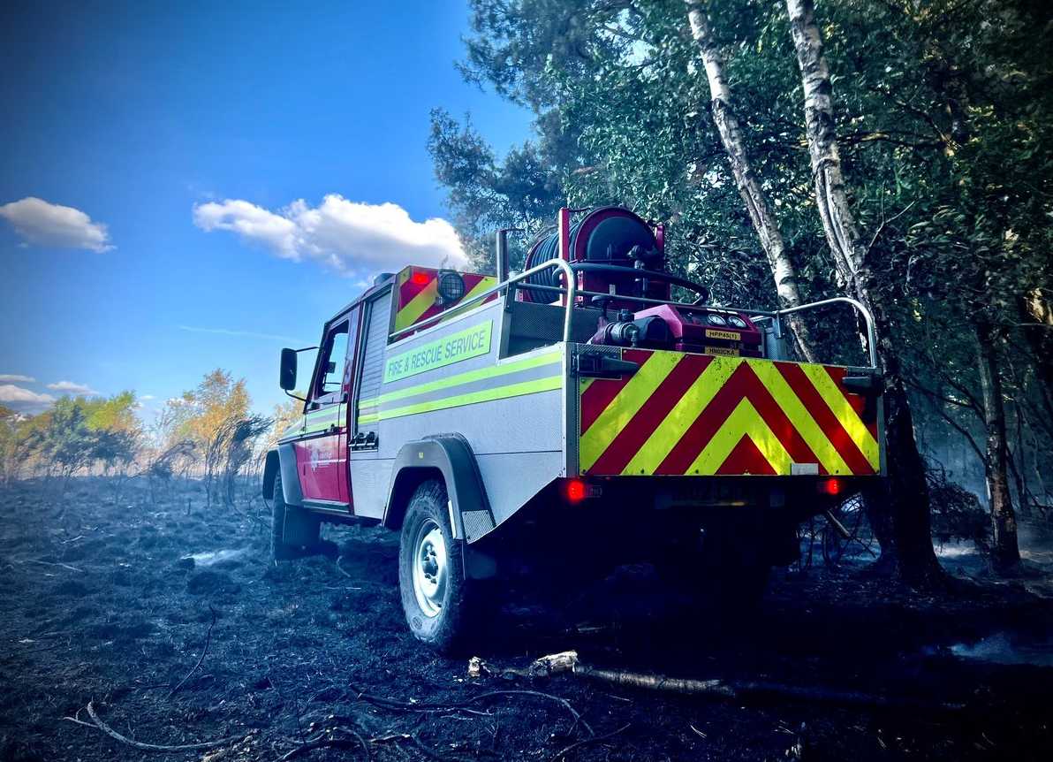


Mid-Year Performance
1st April 2022 to 30th September 2022
This report focuses on our performance in 2022/23 (1st April 2022 – 30th September 2022) across key areas aligned with our Safety Plan priorities, as well as other crucial areas including the progress of our Year 3 Safety Plan improvements and compliance with national Fire Standards

Slide 2

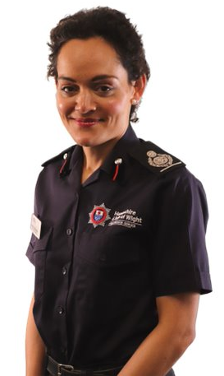
Mid -Year Performance foreword
2022/23
In the first six months of this financial year, we saw unprecedented weather with three extreme heatwaves coming to the UK in June, July and August. This caused significant impact to our people and communities, as well as our partner agencies.
The extreme weather conditions had a significant impact on the number of fire incidents, particularly to outdoor and grass fires where, for example, we saw an 800% increase in outdoor fires in the first week of August 2022, compared to the previous year, with an 80% increase in outdoor fires over the whole six-month period.
Fires in the open, particularly large fires, are also resource-intensive, which has seen some additional pressure on our finances. For example, an average of four appliances were sent to large open fire incidents from 1st July to 16th August 2022. However, many open fires utilised significantly more pumping and special appliances. This resulted in business continuity plans being invoked across the Service to ensure our resources were focused on our priorities. We are immensely proud of our colleagues' commitment and dedication to keep our communities safe during these extremely busy times. With extreme weather predicted next year and on an ongoing basis, we will continue to work with our partner agencies and local authorities to help alleviate the impact and prevalence of such fires, including, for example, through targeted communication campaigns. This year our wildfire prevention messages reached more than 240,000 people on our social media channels.
We have also seen many changes to the UK economy which are impacting on people’s lives in the communities that we serve: from increased gas and electricity bills, increasing interest rates affecting mortgages, and pension uncertainty. We have a responsibility to ensure that the people in our communities are safe in their own homes. In response to the increased cost of living, our new ‘5Cs’ campaign (carbon monoxide, cooking, clothing, candles, and chimneys) increases public awareness of the dangers and empowers them to reduce the risk of fire in their home. We know that the cost-of-living crisis will bring new challenges for people and there is a need to share simple safety messages with them. Economic factors, including deprivation, are a significant fire risk factor, and between April and September this year we saw 508 dwelling or other residential fires, up 7% from the same period in 2021.
We continue to focus heavily on our delivery of Safe and Well visits, which has resulted in a significant increase of 41% more visits than we delivered in the same period last year (up to 5,848 visits). This provides further support to our communities, with visits targeted based on risk. Finally, we are also promoting our free Safe and Well visits to the most vulnerable people in our communities, as well as working with partners to offer this targeted support to those in fuel hardship. We also have a free online tool that allows individuals to assess their risk, which may lead to a visit.
Furthermore, on-call availability has decreased from last year which has seen some on-call stations go off the run for periods of time. There are several reasons for this including retirements, targeted recruitment only at specific stations (based on risk and need) and on-call colleagues crewing Land Rovers, water carriers and other special appliances during the extreme weather. Overall, despite the reduced availability, it is important to note our on-call teams worked tirelessly over the periods of extreme weather whilst putting the Service above family and personal life. Finally, it is also important to note that despite these pressures, we maintained our average critical response time at around 7 minutes 30 seconds.
DCFO Shantha Dickinson
Director of Policy, Planning and Assurance

Slide 3










Performance Summary
3,188
fires
Up 39% vs 2021 owing to the summer heatwave and large numbers of fires in the open
11,125
Incidents attended
4,191 False alarms
3,746
Special Service Calls
Includes medical co-responding, RTCs, effecting exit / entry, and other rescues
Average critical response time
7 mins 34 secs, +3 seconds vs 7:31 in 2021
39% reduction of fire casualties
41% increase in Safe and Well visits with 5,848 delivered
Ongoing cost pressures mainly relating to inflation, which will have a significant budget impact for 2023/24 and beyond
7.1 average shifts lost to sickness, vs 6.1 in 2021
15 more leading (66) than lagging (51) health and safety indicators
56% accounted for long-term sickness
93% of Site Specific Risk Information (SSRI) in date
94% of the 155 fire standards requirements have ‘reasonable’ or ‘substantial’ assurance that we are compliant

Slide 4
Incident Summary
11,125
Incidents attended +326 (+3%) vs 2021/2022, and +480 (+4.5%) vs the same period in 2020/21
The rolling 3-year average for incidents (2020/21-2022/23) is 10,856.
As noted below significant increases in fires (caused by the extreme heatwave), and slight increases in false alarms, have been offset by reductions in Special Service Calls (SSC)
Fires +895 (+39%) vs 2021/22
Three-year rolling average for fire incidents is 2,722
This increase is primarily caused by an increase in grass fires (+609, +99%). There was also a large increase (+44%, +140 incidents) in other outdoor fires compared to last year.
This was influenced by a long period of extremely hot and dry conditions and although we issued strong communications, supported by local campaigns, for safer use of BBQs and other behaviour, we still saw high incident volumes.
3,188
False Alarms +130 (+3.2%) vs 2021/22
Three-year rolling average for false alarms is 4,040.
This slight increase was influenced by an increase in Apparatus (smoke alarms) for house (single occupancy), up to three stories and sheltered housing – not self contained, but this was mitigated by a large decrease in non-residential alarms. False Alarm Good Intent saw a large increase, this was primarily due to Bonfires and Controlled Burnings. There has also been an increase in malicious calls, primarily concerning non-residential premises. We may see further rises owing to economic factors influencing behaviour changes relating to increased levels of alternative cooking or heating device use.
4,191
3,746
Special Service Calls (SSC) -699 (-15.7%) vs 2020/21
Three-year rolling average for SSCs is 4,095
This was influenced by a decrease in co-responder calls, due to the easing of the pandemic impact and reduced medical response requests from, and reduced pressure on, the ambulance service. There was also a slight reduction in RTCs, assisting other agencies and effecting entry/exit.

Slide 5


Fatalities & Casualty Summary
Fire fatalities & casualties by all incident types
3 fire fatalities
3 fire fatalities were recorded on IRS this year vs 2 in the previous year. Two out of the three recorded fatalities were aged 70 plus and were likely caused by smoking materials. Both fatalities had mobility issues. The third fatality was 60 plus and had cognitive impairment issues with the fire likely being caused by an electrical fault. It is important to note that two additional fatalities still require coroners fire death confirmation.​
vs a three (and five) year average of 3 fatalities per financial year
The national trend has seen a decrease in fire-fatalities year-on-year since April 2017 to March 2021, from 338 to 237. However, this figure has increased to 273 in April 2021 to March 2022 (+15%). The Home Office have not yet provided any figures for 2022/23.
The pandemic has also exacerbated risk factors, such as health, finances and behaviour changes (alternative sources of fuel, heating and lighting); these will be intensified by the current financial climate with additional pressures expected following the October 2022 energy price increase.
Analysis of multiple years of fire fatalities and severe casualties shows the main risk factors were smoking, poor mental health, alcohol or substance misuse, and poor mobility or physical impairment. We continue to work with partners, including in health, to further explore indicators of frailty and vulnerability to inform our assessment of community risk.
39 fire casualties
62% male, 17% related to cooking
36% female, 0% related to cooking
Down 39% from 64 in 2021/22
vs a 3-year average of 48
vs a 5-year average of 50
44% (17) of casualties were given first aid at the scene. This was followed by 36% (14) who went to hospital with injuries that appeared slight. Combustibles and heat source being brought together accidentally was the main cause of fire casualties, 18%.
197 RTC casualties
-12% vs the 3-year average of 223
-16% vs the 5-year average of 234
Analysis over a 5-year period shows the majority of RTC casualties were male (55%) and within the 17–40-year-old age range. 63% of these injuries were ‘slight’ over the 5-year period.
104 SSC casualties
-15% vs the 3-year average of 122
-20% vs a 5-year average of 131
-24% vs April – September 2021
Influenced by a 19% decrease in assisting other agencies (52 to 42)

Slide 6


Our Communities
57.6%
On-call availability
vs 68.3% in Apr-Sept 2021. This decrease was caused by increased sickness and the heatwave impact, e.g., with staff crewing special appliances owing to the nature of our incident demand. Furthermore, we continue to experience challenges recruiting for daytime cover on our on-call stations; therefore, reducing availability during weekday periods as well as adversely affecting our ability to crew 2nd appliances.
93.2%
Whole-time availability
vs 86.9% in Apr-Sept 2021. This illustrates an increase from last year (+6.3%), which is reflective of whole-time staff no longer being required to support partners with pandemic-related activity. Availability was not at 100% owing to sickness, and other factors unrelated to crewing (vehicle maintenance, kit changes, and welfare breaks).
Critical response
7 mins 34 secs, +3 seconds vs 7:31 in 2021, but compares well vs other FRSs
Urban (all in) 7 mins 21 secs Rural (all in) 10 mins 58 secs vs Urban 7:19 & Rural 10:40 in 2021/22. Rural response times have also been impacted by the need for some appliances to travel into other station grounds due to incident location and availability.
vs 4150 (+1698) April 2021 – September 2021
Increase by 41%
The rolling average for 2020/21- 2022/23 is 4,398
5,848 Safe & Well
visits carried out
81% completed on time vs 70% April 2021-September 2021
Around a quarter of our contacts with vulnerable people do not result in a completed Safe and Well visit. We are looking into this with our partners to understand what the causes of this are, particularly in urban areas where completing a visit has at times proved more challenging.
504 total audits
-180 (-26%) vs Apr 21 – Sept 21
+334 (+196%) vs Apr 20 – Sept 20
Three year rolling average: 453
77% (391)
Fire Safety Audits completed on time
vs 79% (540) April 2021 – September 2021
vs 73% (124) April 2020 – September 2020
The rolling average for 2020/21 - 2022/23 is 78% (352)
The reduction in audits this year is due to resourcing and capacity pressures where some staff are still in training phases and there are also some vacancies which are either on hold or being advertised.
918 total consultations
+8 (+1%) vs Apr 21 – Sept 21
+392 (+74%) vs Apr 20– Sept 20
99% (908)
Building Regulation Consultations completed on time
completed on time vs 94% (852) April 2021 – September 2021
vs 97% (512) April 2020 – September 2020
completed on time rolling average for 2020/21 - 2021/22 is 96% (757)
327 total consultations
-57 (-15%) vs Apr 21 – September 21
+82 (+33%) vs Apr 20 – September 20
91% (297)
Licensing Consultations completed on time
completed on time vs 94% (363) April 2021 – September 2021
vs 87% (214) April 2020 – September 2020
completed on time rolling average for 2020/21 - 2022/23 is 91% (291)

Slide 7

Our People
Sickness absence
7.1
average shifts/days lost to sickness
+1.0 shifts lost (+28%) vs 2021
11,185 shifts were lost between April and September 2022, equating to 7.1 average shifts lost.
Increase from 8,916 in the same period in 2021 (+28%). This is owing to increases in all staff groups other than Control, and an increase in long-term sickness. The rolling average for the previous 3 financial years is 5.7 average shifts lost.
Long-term sickness has increased compared to last year with 56% of sickness in April to Sept 2022 being attributed to long-term absence (short-term, 44%), up from 49% in the same period in 2021.
Green book saw the largest increase in overall sickness levels from 1,241 shifts lost in April to Sept 2021 compared to 2,159 for the same period in 2022. This is owing to increases in COVID-19 and mental health sickness (up from 448 shifts lost to 614).
The upward trajectory of sickness, and changing nature of sickness types, correlates with national trends and benchmarks, both within the Fire and Rescue sector and in other sectors. HIWFRS sickness data shows we are slightly above the national average based on the latest benchmark data.
Health & Safety
66
-1 vs 2021/22
3-year average: 58
Leading (near miss/cause for concern) cases have decreased during this period and although one lower than the previous year it is positive that they still significantly exceed the lagging indicators. These figures have increased by 57% compared to 2020/21: 42 leading cases, again showing a positive direction of travel.
Lagging (injury/ill health) cases have decreased by 13% during this period compared 2021/22. The injuries are deemed minor and not requiring a RIDDOR. Lagging cases have increased significantly by 51% compared to 2020/21: 30 lagging cases.
RIDDOR incidents have remained at 11 when compared to the same period last year. RIDDOR incidents have increased by 83% compared to 2020/21: 6 RIDDOR cases.
51
-8 vs 2021/22
3-year average: 47
11
+/-0 vs 2021/22
3-year average: 9
Injuries have decreased slightly in comparison to April to September 2021. It is also important to note that, positively, leading indicators outweigh lagging indicators by 15 cases. Most injuries happen during training and operational incidents, because of the environment they are more at risk. These mostly involve strains, sprains, slips, trips and falls, manual handling and burns.
There have been 11 injuries reported under RIDDOR (Reporting of Injuries, Diseases and Dangerous Occurrences Regulations) preventing Fire and Rescue Service (FRS) staff from working 7 days or more, subdivided as follows: slips, lifting/handling, fall from height and other. These injuries occurred during attended fire incidents, gym/PT sessions and drill yard/training. The figure of 11 is the same as the 2021 reporting period.

Slide 8


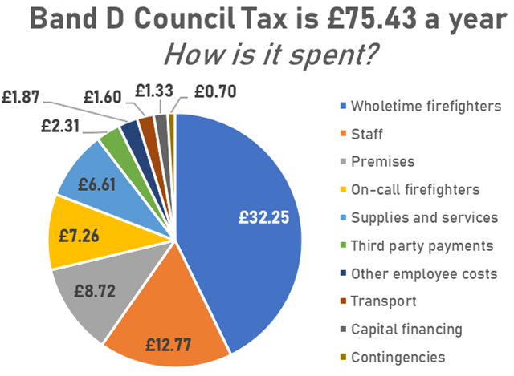
Public Value
HIWFRS cost per population
It is important to note the impact of inflation on these figures
2022/23 estimated cost per population
Comparator data from CIPFA is not yet available for 2022/23
£41.47
£40.97
2021/22 estimated cost per population
Source: HIWFRS finance data, cash- not real-terms.
Cost breakdown & indication of how our communities’ council tax is spent
The Fire Authority has received an update on the forecast financial performance for Q2 2022/23 This report forecasts a net underspend of £0.59m (less than 1% of net service expenditure). Inflation is a driver of significant cost pressures, offset by the use of contingencies, one-off budget underspends, lower capital financing costs and additional income.
Inflationary pressures largely relate to pay and energy costs and will also have a significant impact on the 2023/24 budget. These issues are not unique to the Authority or the fire sector, compounded by significant uncertainty around the economic outlook for the UK. Officers continue to monitor the situation closely and the Chief Financial Officer has produced forecasts using prudent but realistic assumptions. The Fire Authority has agreed to the use of reserve contributions to close any budget gaps in the short term, although existing reserves balances can only be used once and reducing planned contributions to reserves will impact the delivery of future priorities.
The two tables to the right illustrate where our money is spent, with the bottom table providing indicative information on how council tax money is spent.
Quarter 2 position | Budget £’000
Wholetime firefighters | 37,125
Staff | 15,041
On-call firefighters | 8,318
Other employee costs | 2,179
Total employee costs | 62,663
Premises | 8,744
Supplies and services | 7,893
Third party payments | 2,792
Transport | 1,739
Capital financing | 1,529
Contingencies | 800
Gross budget | 86,160
Net budget (less £3.277m income) | 82,883

Slide 9
Additional activity
Learning & Improving
Year 3 Safety Plan improvements
We committed to completing 23 improvements. We have completed 2 of these to date, with overall progress assessed at 33% for all actions.
16 of the remaining actions are on track to complete by the end of the year, four are not yet started and one is delayed.
National Fire Standards compliance
Twelve national fire standards have been published, covering a wide range of areas, with a total of 155 requirements (‘desirable outcomes’) underneath the 12 standards.
The Service has undertaken a significant amount of assurance activity to assess our compliance with the standards, which identified we have 'reasonable' or 'substantial' assurance in 145 (94%) of the 155 desirable outcomes.
Risk information
We have introduced a new approach to Premises Risk Information, consisting of 5 levels of risk information, including Site Specific Risk Information (SSRIs), Operational Pre-Plans and Post Incident Support Plans.
93% of SSRIs in date, as at September, with ongoing focus in this area
Earlier in the year, we received our second full inspection from Her Majesty’s Inspectorate of Constabulary and Fire and Rescue Services (HMICFRS). The report is set to publish in early 2023; however, we have already started commencing some improvement activity based on some early findings the inspection team shared with us.
We have begun work to design our next Safety Plan which will 2025-30. This two-stage piece of work will begin with thoroughly identifying the risks our communities face.
We continue to support the ongoing vaccination efforts for Covid-19 with clinics continuing to take place in various stations. We continue to host two clinics each week, in partnership with Solent NHS Trust.
Following a formal request from National Resilience Assurance Team, HIWFRS deployed a team of 18 HIWFRS colleagues to support to Royal Berkshire Fire and Rescue Service on the day of the State Funeral for Queen Elizabeth II. We also stood up a Detection, Identification and Monitoring (DIM) team in London to cover the event.
Wellbeing support is being provided to staff in reference to the impact of increased cost of living with information on energy prices, benefits and tips on shopping, cooking and overall tips to help manage their money. The information is posted to our Portal and includes a ‘Feel Good Friday’ post on a monthly basis with other wellbeing related information.

